Slide 1
Immutable Infrastructures in SQA
BYUNG KANG / ROBBY LAGEN
Notes:
<Introduction>

Slide 2
Immutable Infrastructures?
Notes:
So who here has heard of immutable infrastructures?

Slide 3
Immutable Infrastructures?
Notes:
What about tools like docker?

Slide 4
Immutable Infrastructures?
Notes:
Vagrant?
So some of you guys probably know these tools but not the term for what they’re trying to achieve. And that is to make your infrastructure as immutable as possible.

Slide 5
Immutable Infrastructures?
Notes:
So what do we mean by immutable? Well, if you’re familiar with java or most other languages, strings are immutable. That is, you can’t modify the original string. and instead a new string is returned. It’s the same concept here. Instead of modifying an existing infrastructure, you return a new infrastructure.

Slide 6
Immutable Infrastructures?
Notes:
What about infrastructure? This one’s a little vague because the basic definition is the organization of the various parts of a system. All to perform some kind of an operation. You can think of roads that allow us to drive safely, or lighthouses to guide ships. But in our case, you can think of it as the environment that allows our software to run. For example, an app may depend on some dependencies and configurations for it to work. Then these dependencies and configurations must be part of the environment. That’s what we mean by infrastructure.

Slide 7
Immutable Infrastructures?
A software environment that cannot change.
Notes:
So putting these together, it’s a software environment that cannot change. If we want to modify something like updating a dependency, we’d have to create a new environment with those changes added. Again, going back to strings. It’s just like it.

Slide 8
“Immutable infrastructure is an approach to managing services and software deployments on IT resources wherein components are replaced rather than changed. An application or service is effectively redeployed each time any change occurs.”
Margaret Rouse
Notes:
Here’s a more technical definition.

Slide 9
Destroy and recreate the entire infrastructure after an IT-related update.
Notes:
Or…

Slide 10
youtube video downloader
Notes:
Let’s go over a very simple example that will help us understand why this would be useful. Say we’re wanting to create a youtube video downloader. All it does is download youtube videos to your hard drive.

Slide 11
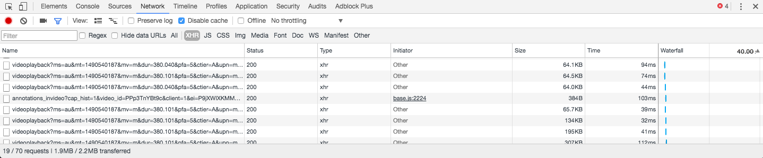
youtube video downloader
Notes:
If you remember back in the days, youtube didn’t buffer their videos. So you could literally open up your browser’s devtools and find the video it downloaded. Then save it to your computer.
However, this is how it is today. Youtube sends chunks of the video depending where you are on the video. This isn’t very useful to us. Although we could download every one of them and combine them manually, that’s very time consuming. Imagine a video that’s longer than an hour. That’s just not worth the trouble.
What we want is a tool that will fetch those chunks in parallel and combine them for us. This is actually how most youtube downloaders work.

Slide 12
Video -> Audio
Notes:
But let’s suppose that we want to add a feature. We want the ability to extract just the audio portion of the video.
So imagine a developer going to work on it and pushing his code to github. Then the QA team pulls the code to test it. However, it doesn’t work. So they tell the developer that worked on it that it doesn’t work. Then guess what the developer says

Slide 13
Video -> Audio
“It works on my machine”
Notes:
Pretty typical right?
Well, it turns out the tester’s machine didn’t have a dependency that converts video to an audio format. But the developer already had it in his machine, so he didn’t know.
And this is a very simple example, but imagine bigger applications with more dependencies. That would be very hard to keep track of.
And that’s where tools like docker and vagrant come in.

Slide 14
config
Notes:
So most of these tools have a config file where you specify the operating system, dependencies and configurations. For example, a web server may need certain ports exposed, install a runtime to run the app, create a privileged user so you don’t run as root by default. And so on.
By putting these in a file, it can actually become version controlled. If you think about it: version controlling your entire environment. It’s like a blueprint of everything that a software needs to run.

Slide 15
config
DEV
Notes:
From the developer’s point of view, whenever someone adds a dependency, that dependency would be defined in the config file. So if another developer wants to build on top of his changes, it would pull the updated config file and use docker or vagrant to recreate the environment.

Slide 16
config
DEV
QA
Notes:
The same goes for QA. They’d have the benefit of testing in the exact same environment as the developers, which not only saves their time, but the developers’ time to see why something’s not working.

Slide 17
config
DEV
QA
OPS
Notes:
And finally the operations team have a much easier time putting the product in production.

Slide 18
Docker in SQA
Notes:
OK so now we know what an immutable infrastructure is, we’re going to look at a specific tool called docker. As well as its role in SQA

Slide 19
VMs vs containers
Notes:
So before we get to that, we need to understand the difference between virtual machine and containers. I’m sure most of us have heard of virtual machines, but maybe not containers. And this is important to go over it because docker uses containers.

Slide 20
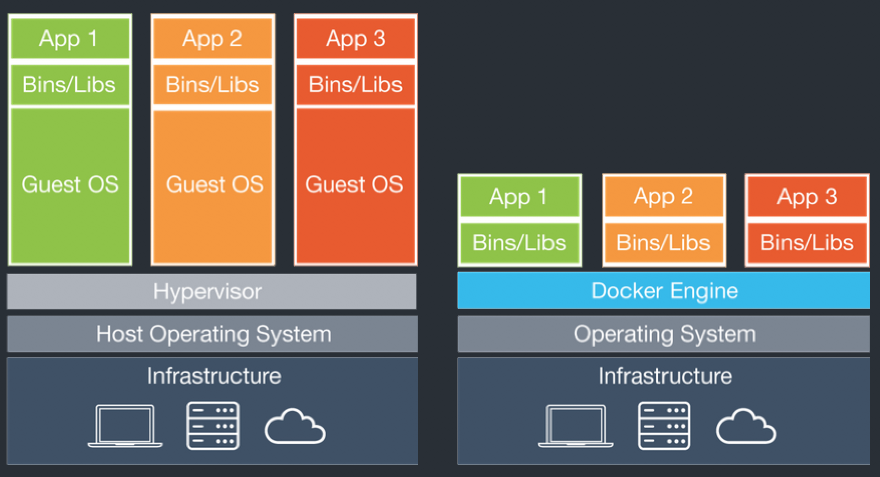
VMs vs containers
Notes:
On the left side we have a virtual machine..how it looks under the hood. They’re powered by a hypervisor. They create and run virtual machines so that each VM has its own isolated space. If you’ve ever used something like virtualbox, you know you can have multiple virtualized environments. And the main example that uses it is cloud services. Instead of a single server for each app, it creates multiple virtual machines in that server. So a single server may have multiple apps running on it. This is very efficient in terms of CPU and memory usage.
Containers on the other hand don’t have an isolated operating system. It actually uses the same host kernel to run. So if you’re running containers on a linux machine, they’d use the linux kernel. If you’re running them on windows, they’d use the windows kernel. So the drawback is that you can’t choose what operating system you want to use. But there is a workaround, which is to use a virtual machine so that you can choose the kernel you want to run on. But because the fact that it doesn’t need a separate operating system, it’s extremely lightweight. They use even less CPU and memory than virtual machines, and they’re much faster.
//Also, something I didn’t understand at first is that a container is usually associated with a single command.
//Also if you’ve never used containers before, one major difference is a container is usually does one thing. So for example, it would run a web app and that’s it.

Slide 21
Dockerfile
FROM ubuntu
RUN apt-get install –y software-properties-common python
RUN add-apt-repository ppa:chris-lea/node.js
RUN apt-get update
RUN apt-get install –y nodejs
RUN mkdir /var/www
ADD app.js /var/www/app.js
EXPOSE 8080
CMD [“/usr/bin/node”, “/var/www/app.js”]
Notes:
Here’s the configuration file that docker uses. It’s called a Dockerfile.
So starting from the top, the FROM command specifies the linux distribution. The RUN commands contain commands to build the container image. Here, we’re installing some dependencies to run a nodejs app.
The ADD command will add our local app.js file to the container.
EXPOSE port 8080 exposes the container’s 8080 port
Then finally CMD specifies the process that should run when startingthe container. Here, we’re simply running our nodejs app.

Slide 22
Dockerfile
docker build –t <tag-name>
docker run –p 8080:8080 <tag-name>
Notes:
And finally, to create the environment, we first build an image. Then we start a container based off that image.
Here, the –p flag indicates the mapping between the host port and the container port.

Slide 23
Testing becomes system agnostic
Notes:
So the benefits for testers is that... testing becomes system agnostic. It doesn’t matter which machine you’re using. It should closely reflect the production environment.
Because containers are lightweight and self contained, we can start up a container test its behaviors as if they’re on a production machine. It doesn’t matter which machine we’re using. Even if we’re using a different OS, we can use a virtual machine to run docker, and that would use the same kernel as the production machine.
// There’s no overhead to manually setup the environment just to test a particular thing.
//But say you’re using a windows machine, when the container can only run on linux. Because remember, a container shares the host OS. To get around this, all you have to do is run a linux virtual machine and run that instead.

Slide 24
Painless integration and regression testing
Notes:
With another tool called docker-compose, you can specify a collection of containers to run together with a single command. This makes integration testing much faster and less error prone. You can also delete them just as easily.

Slide 25
Easy performance testing (scalability, reliability, resource usage)
Notes:
Also with docker-compose, it’s easy to run multiple instances of a container. You just have to specify a number. And with that in place, you can start testing other things like scalability, reliability, and resource usage.

Slide 26
Anyone can test
Notes:
And more importantly is that anyone can test. Usually QA has their own set of servers to test things, but now developers can setup their own. This allows the developers can test their code in terms of the entire infrastructure just as easily, and catch defects early on. Even before it reaches QA. This ends up saving a lot of time for everyone in the team.

Slide 27

















Immutable infrastructures are becoming a standard
Notes:
Immutability infrastructures are becoming a standard at a lot of places.
I have a friend who works at apple as an internal tools developer who says they’re using vagrant. He also mentioned that they’re starting to pick up docker as well.
Also, Microsoft. Theyre using docker for their new mvc core framework.
Google cloud platform is pretty much all containers.
So it’s definitely something worth learning. We’ve seen how It increases the level of productivity for QA, and helps them focus on what they do best, which is testing.

